Slide 1
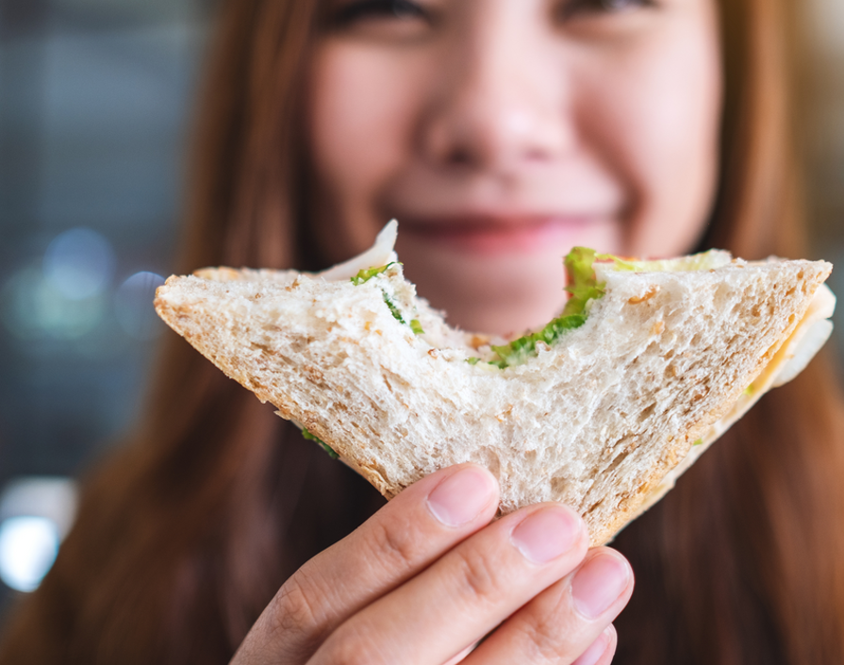
What We’re Watching No. 10 – 2023
Most people would likely agree that grains are foundational to the food landscape. But current dynamics raise the question:
are grains actually an underleveraged ingredient?
Food industry stakeholders continue to confirm the value of grains through high-scale usage on menus and in retail food products. Although overall usage within all of food has remained relatively flat in the past 5 years, 2023 has seen elevated consideration across specific food types and within specific grain types.
Consumers certainly know of grains (any). In fact, overall awareness is nearly universal. And perceptions about how they deliver taste and nutritional value when used as an ingredient are very favorable. But there is softness in what consumers really know about grains, and opportunity lies in the closing of that gap.
Implications and Opportunities:
Prioritize usage (and communication) of grain-inclusion in food items. Grains carry strong equity with consumers when it comes to their contribution to the overall great taste of food items and there is no more influential factor on the food choices of consumers.
Communicate the nutritional benefits of grains when used as an ingredient to fill the knowledge gap that exists with some consumers.
Evaluate opportunities with alternative grains that are being used at dynamically increased levels in 2023. Are Spelt, Pearl Barley or Millet on your radar.¹
1 - Non-Exhaustive
1
Ardent Mills Copyright © 2023 – Ardent Mills Confidential and Proprietary.
Notes:
Clean up

Slide 2
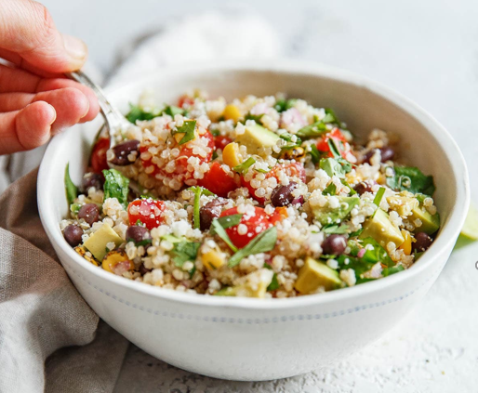
What We’re Watching No. 10 – 2023
Grains (any) have a strong standing with all food stakeholders, one that offers opportunity for even greater leveraging.
The more consumers know about grains (any), the more favorable they are to the nutritional contribution they make as an ingredient.
Grains are seeing elevated usage in many new products in 2023. Here are some subcategories and specific grains leading the way:
Consumers are near universally aware of,
and favorable to, grains (any).
Familiarity with grains (any) is strong
but deep knowledge is not fully maximized.
Grains (any) have a POSITIVE Impact on the Nutritional Value of food items:¹
Share of New F&B Products including Grains (any)²
87%
73%
Subcategory* | 2023 (ytd) vs 2022
Dog Snacks/Treats | +18%
Snack Mixes | +16%
Ready Meals | +13%
Wet Soup | +12%
Instant Noodles | +11%
Cakes - Pastries & Sweet Goods | +11%
54%
Very Familiar/Knowledgeable About Grains (any) .¹
38%
Somewhat Familiar/Knowledgeable About Grains (any) .¹
% Agree
Among Consumers
Very Familiar/ Knowledgeable About Grains
% Agree
Among Consumers
Somewhat Familiar/ Knowledgeable About Grains
Foodservice is leveraging the appeal of
grains (any) by increasingly offering them
as stand-alone entree.
Share of Usage in New F&B Products*:
2023 (ytd) vs 2022²
Consumers* strongly appreciate the taste
contribution grains (any) make as an ingredient.
+77%
Impact of Grains on TASTE of food items¹
+46%
+13%
Which grains are among the most commonly used in Grain Salad Entrees? Here are a few of the lead options:*³
+25%
+21%
Growth in the number of Grain Salad Entrees on Total Foodservice menus:
One year growth through
end of Q2 2022.³
Quinoa
Brown Rice
Bulgur Wheat
Barley
Chickpea
+12%
*Among consumers familiar with grains (any)
+7%
*Non-Exhaustive
*Non-Exhaustive
1 - Ardent Mills Proprietary Analysis/Research; 2- Innova Market Insights; 3- Technomic
2

